Slide 1
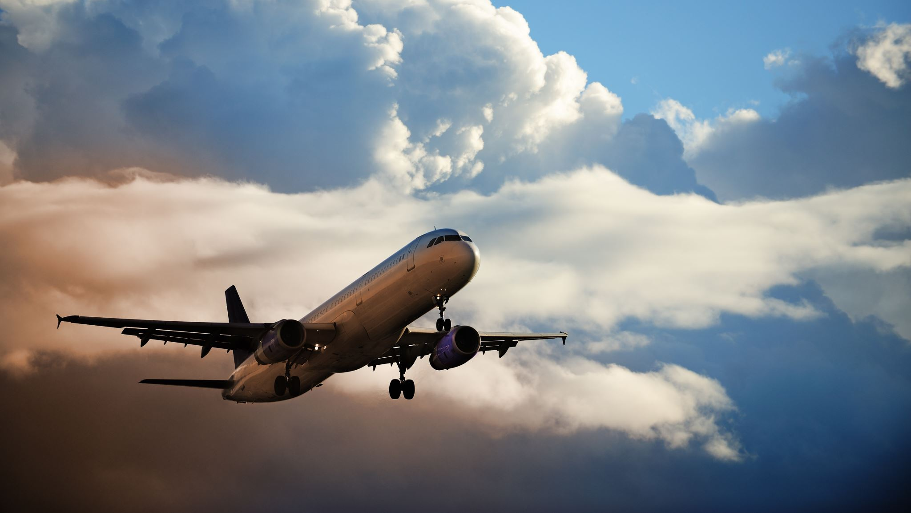
ABC Airlines
Flying you to your next Dream destination

Slide 2
Safety Analysis
Summary
Safety Matters – Debunking what media says with statistics
Aircraft vs Vehicles – What do you prefer?
Fatalities over the years
Takeaways and Recommendations
Legal and Ethical matters
References

Slide 3
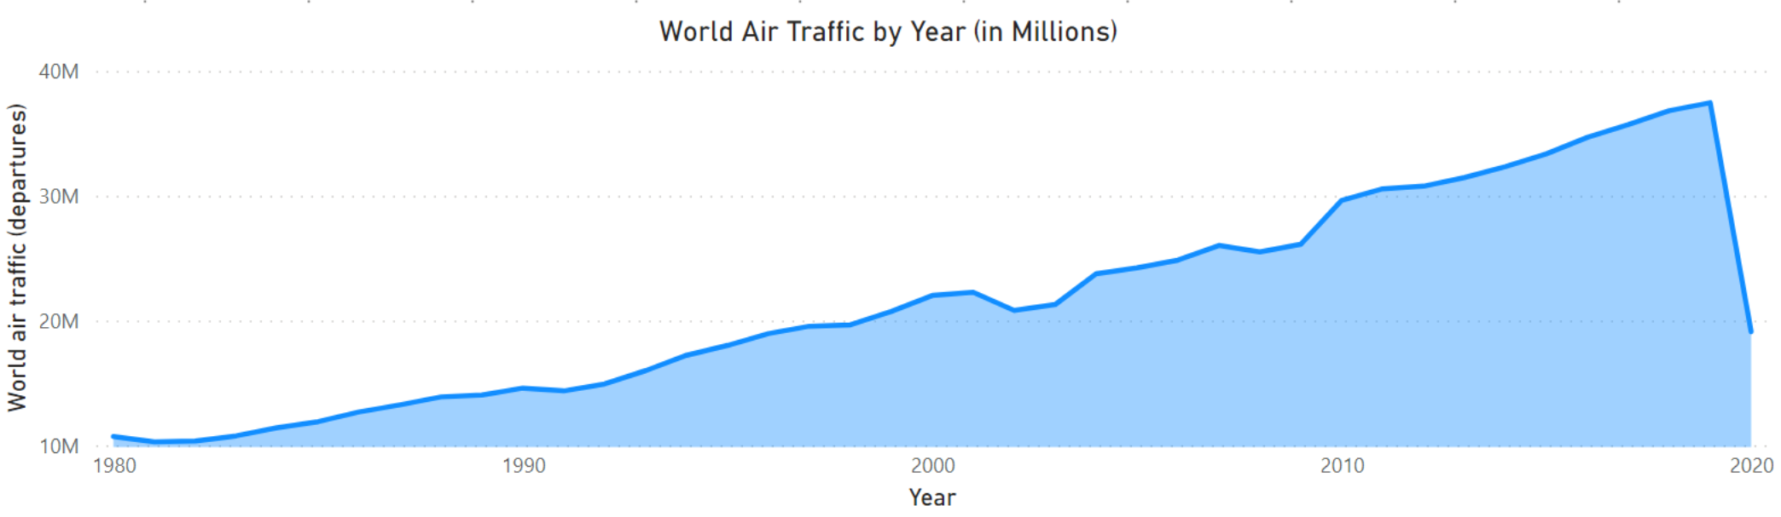
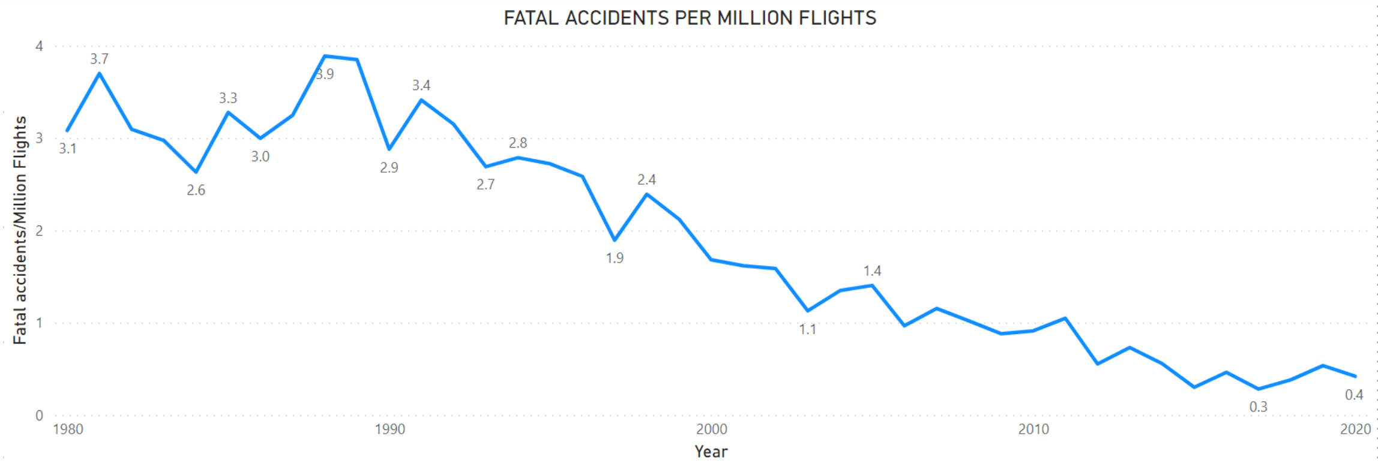
How Safe are we in flight? Media portrays the air travel is unsafe. Is it true? In 2020, there were 0.4 fatal accidents for every million flights. In 2019, the world traffic was about 37 Million, just before the pandemic.
Data Source

Slide 4
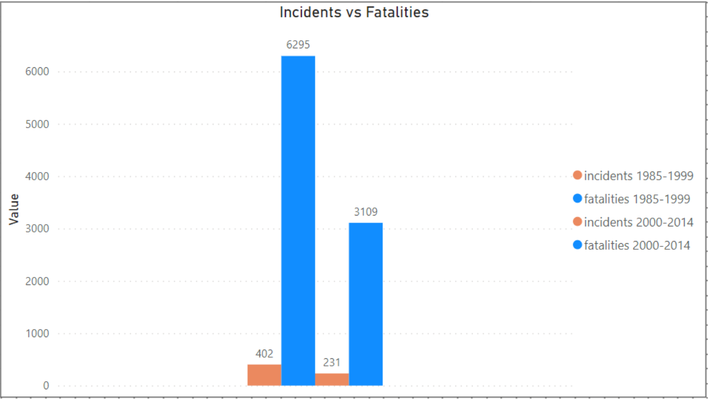
The number of incidents and fatalities have decreased over the years.
Data Source

Slide 5
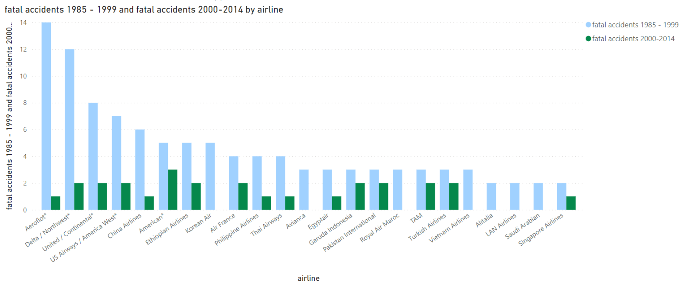
Data Source
Across all the major international and domestic(US) airlines, the fatal incidents are less to none during 2000 - 14.

Slide 6
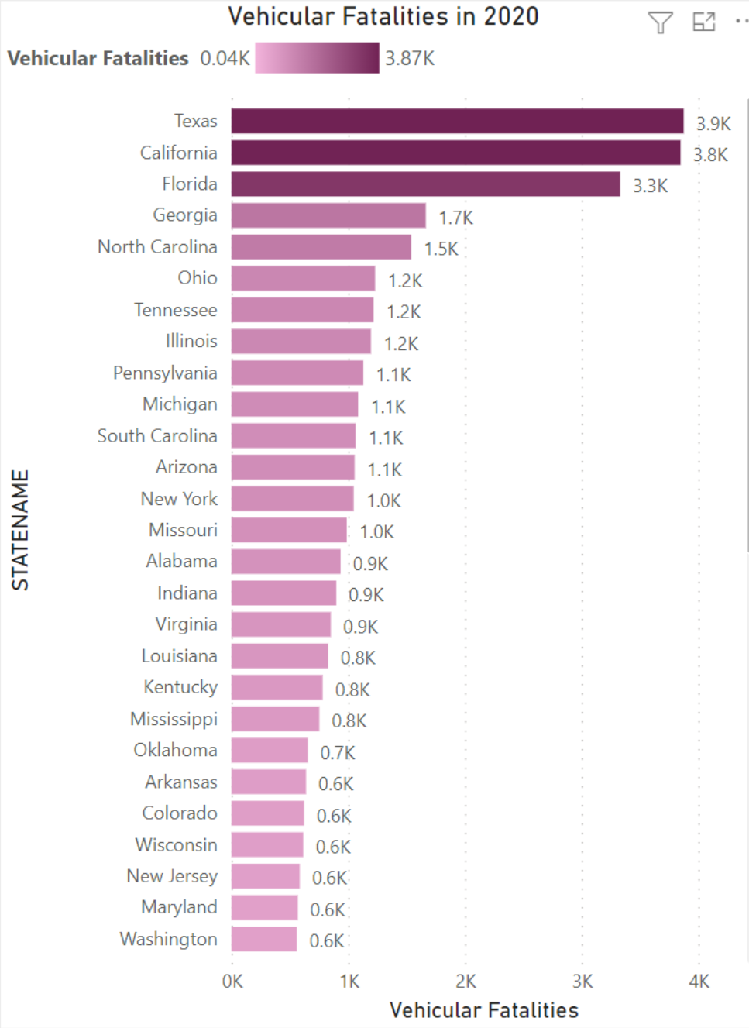
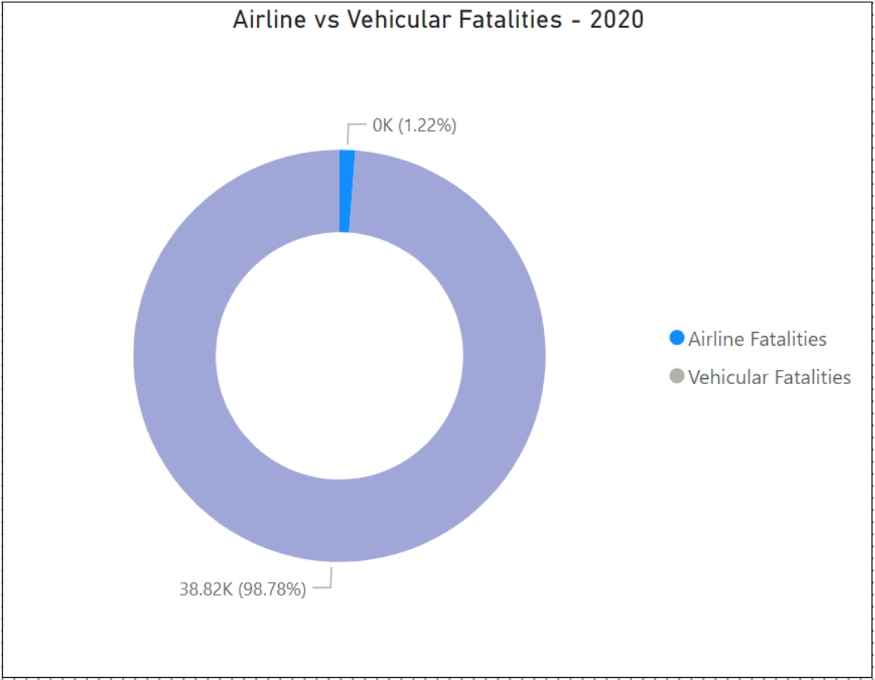
Is vehicular travel safer than air travel? In 2020, Texas alone had about 4000 vehicular fatalities.
The total percentage of Airline fatalities worldwide is negligible when compared to vehicular fatalities just in the US.
Data Source

Slide 7
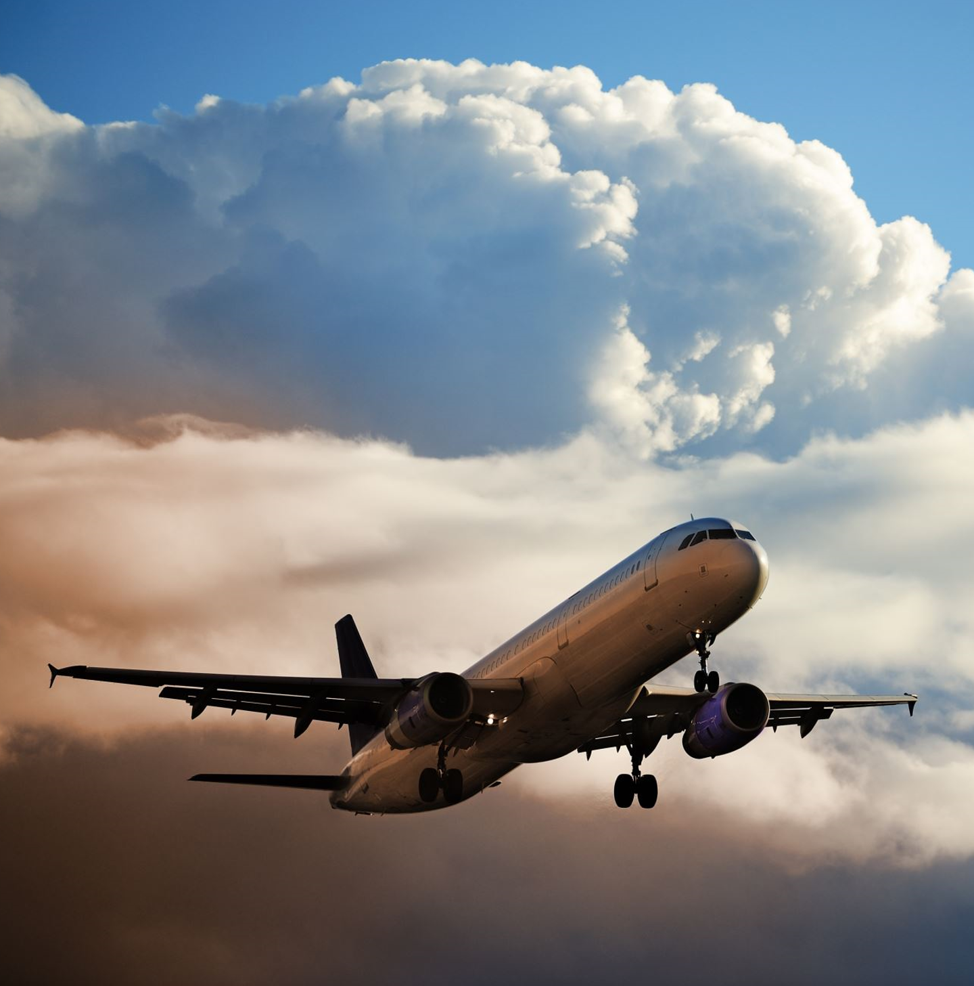
KEY TAKEAWAYS / RECOMMENDATIONS
- Less than 0.5 fatal incidents for every million flights around the world
- There has been drastic reduction in air accidents, possibly due to growth in technology in flights and communication systems
- Across all major international and domestic flights, fatal incidents in the last 20 years have been only 2 to none.
- There are higher chances of fatality due to road accidents than air accidents
- Air travel is safe and convenient.
Where are you off to next?

Slide 8
LEGAL AND ETHICAL CONSIDERATIONS
1. No PII Data has been used for the analysis
2. All data sources are extracted from public domains, shared by organizations for educational purposes
3. All references are listed below
REFERENCES –
Accidents and Fatalities Pery Year -
https://docs.google.com/spreadsheets/d/1SDp7p1y6m7N5xD5_fpOkYOrJvd68V7iy6etXy2cetb8/edit#gid=1448957446
Airline-safety
https://github.com/fivethirtyeight/data/tree/master/airline-safety
Fatality Analysis Reporting System
https://www.nhtsa.gov/file-downloads?p=nhtsa/downloads/FARS/2020/National/

